Slide 1
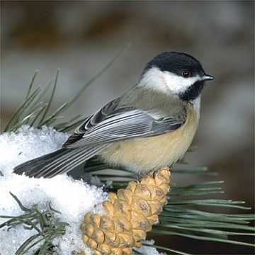
Drivers of Avian Species Richness
Student names removed for anonymity

Slide 2
Hypothesis
1. Points taken in close proximity to the Atlantic coast will have higher species richness.(continental)
2. Areas with agricultural land use will have higher species richness due to reliable source of food.(regional)
3. Avian species richness will be smaller in areas with heavy human influence.

Slide 3
Hypothesis II
4. Regions that are mostly forest will have greater avian species diversity due to availability of niches. (region)

Slide 4
Methods
Points were used from Atlantic coast to -105 west. Surveys were used that had georeference points. Then using the most recent year of that survey the number of avian species was tallied.
Spatial scale of roughly 1:45,000 was used for regional views and 1:5,000 for local.

Slide 5
Bird Count Data (regional)
Coordinates (lat, long) | Bird Count | Forest | Water | Agriculture
35.8179300 , -93.0733200 | 3 | 0.948292 | 0 | 0.030781
38.4539880, -76.0597503 | 13 | 0.451968 | 0.121546 | 0.394876
43.0980545, -70.6612681 | 11 | 0.396547 | 0.517251 | 0.032018
36.7379799, -75.9634293 | 11 | 0.262798 | 0.379414 | 0.283425
39.1589907, -79.3475109 | 14 | 0.927206 | 0.024274 | 0.008786
41.1633169 , -73.1544441 | 11 | 0.01372 | 0.0479372 | 0.010183
41.4479029 , -71.4618924 | 13 | 0.117653 | 0.337942 | 0.065387
42.7496238 , -70.7974096 | 13 | 0.018884 | 0.887221 | 0.02902
44.7726923 , -71.0837528 | 14 | 0.711463 | 0.237602 | 0.013923
44.6128231, -73.2279915 | 7 | 0.362343 | 0.419956 | 0.144123
38.8488000 , -85.4532200 | 9 | 0.652592417 | 0.625924167 | 0.29834664

Slide 6
Coordinates (lat, long) | Bird Count | Forest | Water | Agriculture
41.2877906 , -74.5341242 | 18 | 0.401975 | 0.012589 | 0.51540351
43.0980545 , -70.6612681 | 10 | 0.527116 | 0.01068 | 0.389745746
45.5231700, -93.7543000 | 16 | 0.222967 | 0.35473 | 0.39721941
41.7873310 , -80.0025908 | 8 | 0.58368 | 0.033766 | 0.314135
45.1287151,-67.2785785 | 18 | 0.740307 | 0.147110656 | 0.014610656
35.9236, -84.3493833 | 2 | 0.806504 | 0 | 0.113356338
38.0705, -76.93973 | 3 | 0.376082 | 0.33334 | 0.285023
36.8221167, -76.5489111 | 1 | 0.211259 | 0.333764 | 0.350108
41.7899823, -79.99162219 | 8 | 0.791309 | 0.024326 | 0.155073
39.2897648 , -75.5144038 | 13 | 0.076711 | 0.327192 | 0.118694
41.3739651 , -71.5731218 | 8 | 0.137018 | 0.508718 | 0.57222
42.2944522, -85.3647281 | 6 | 0.631735 | 0.032646 | 0.21163079
39.0471130, -74.9071162 | 6 | 0.528978 | 0.169049 | .118694
36.6710833 , -91.8231667 | 9 | 0.39059 | 0 | .57222

Slide 7
Graph

Slide 8
Graph

Slide 9
Graph

Slide 10
Graph

Slide 11
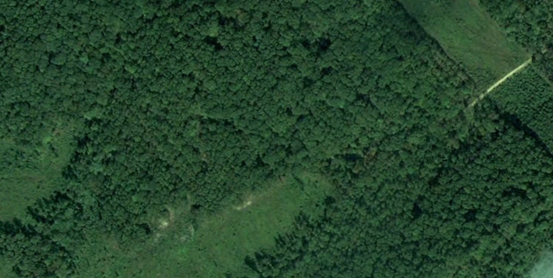

Local
35.9236,-84.3493833

Slide 12
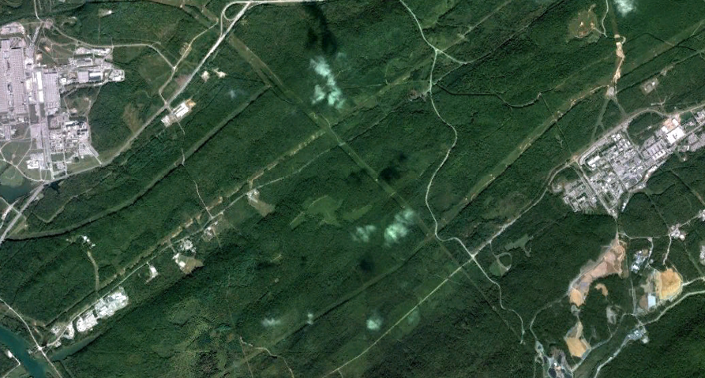
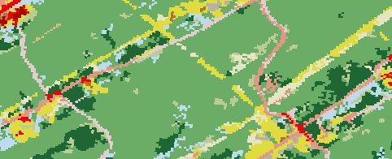
Regional
35.9236,-84.3493833

Slide 13
Conclusion
The graphs generated by the data collected does not support the hypothesis suggesting that bird species richness would be greatest in areas of agricultural land cover.
It was originally hypothesized that water would play a role in bird species richness, however the data does not seem to support this idea.
There seems to be no specific trend regarding species richness and water on the local or regional scale.

Slide 14
Conclusion (cont.)
The data also suggests that points with a greater longitude (more inland) had the lowest species richness which supports our hypothesis of species richness being greater closer to the coast.
The graphs generated by the data collected does support the hypothesis suggesting that bird species richness would be greatest in areas of forested land cover.

